Slide 1
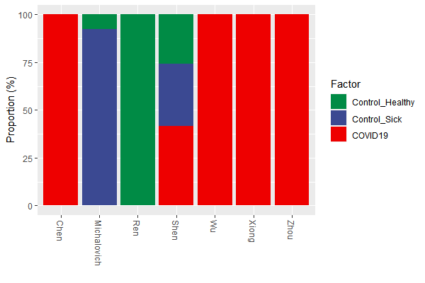
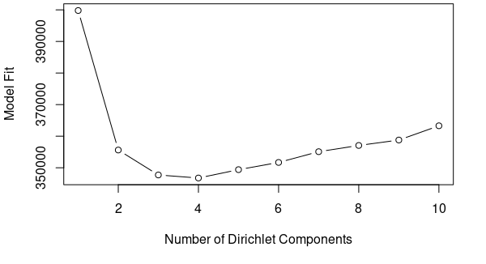
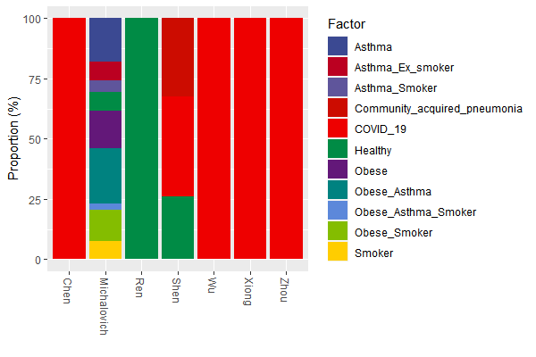
Pre- processing GO_Terms
Pre-processing Steps Taken | Go Term (n) | samples
Subset for biological processes only | 5533 | 167
Removed neg control and Unknown sample types | 3393 | 141
Removed Go terms and samples with summation < 10 | 3470 | 135
Agglomerated Go_terms by name | 3458 | 135
DMM model fit

Slide 2
Go term visualizations
Jochum, Michael D.
2 November 2020

Slide 3
Pre- processing GO_Terms
Pre-processing Steps Taken | Go Term (n) | samples
Subset for biological processes only | 3393 | 167
Removed neg control and Unknown sample types | 3393 | 141
Removed Go terms and samples with summation < 10 | 2212 | 134
Agglomerated Go_terms by name | 2107 | 134
DMM model fit

Slide 4
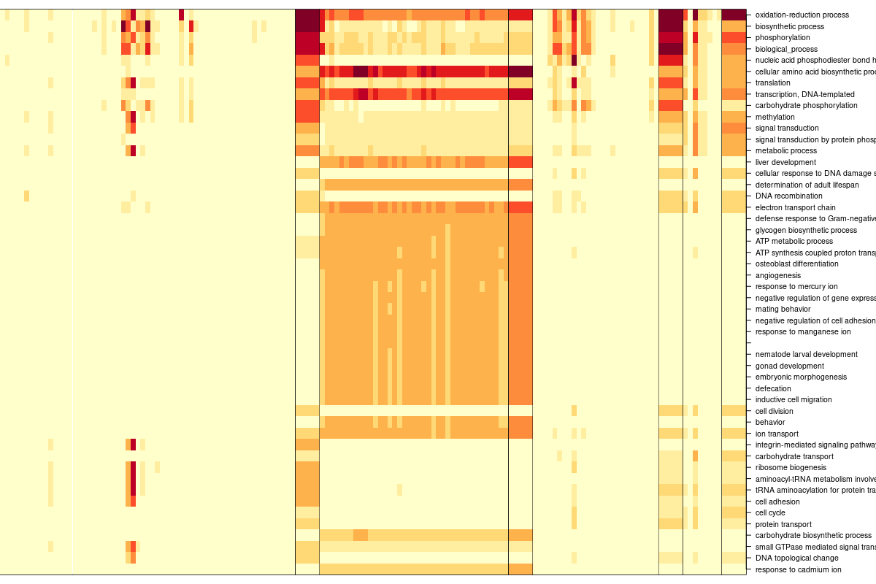
Square root transformed Dirichlet Multinomial Mixtures Community typing (k=4)

Slide 5
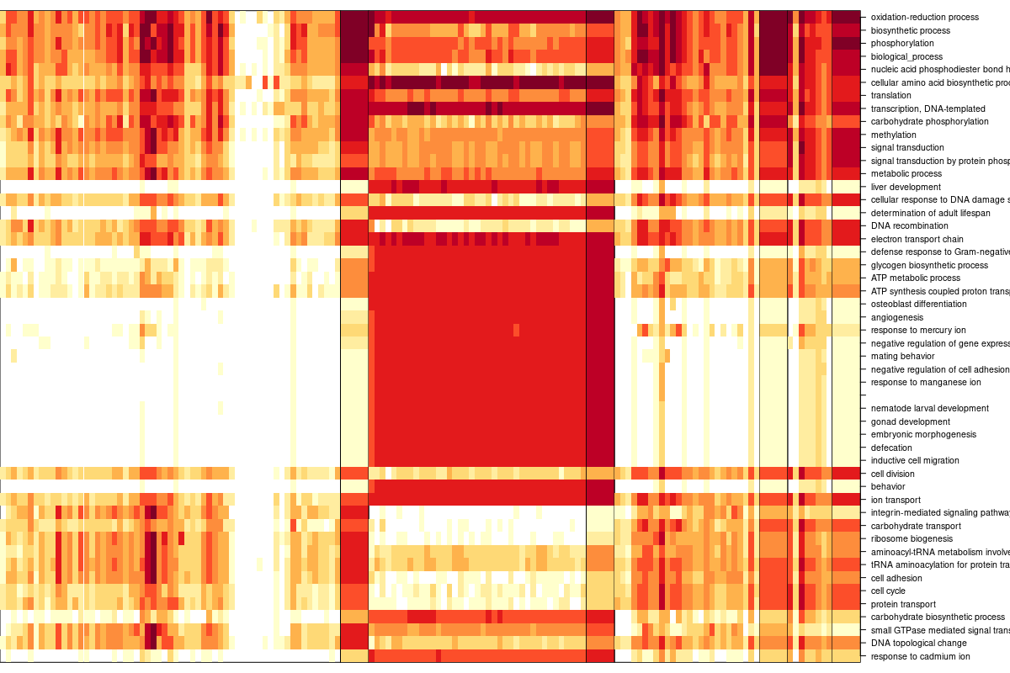
Log 2 Dirichlet Multinomial Mixtures Community typing (k=4)

Slide 6
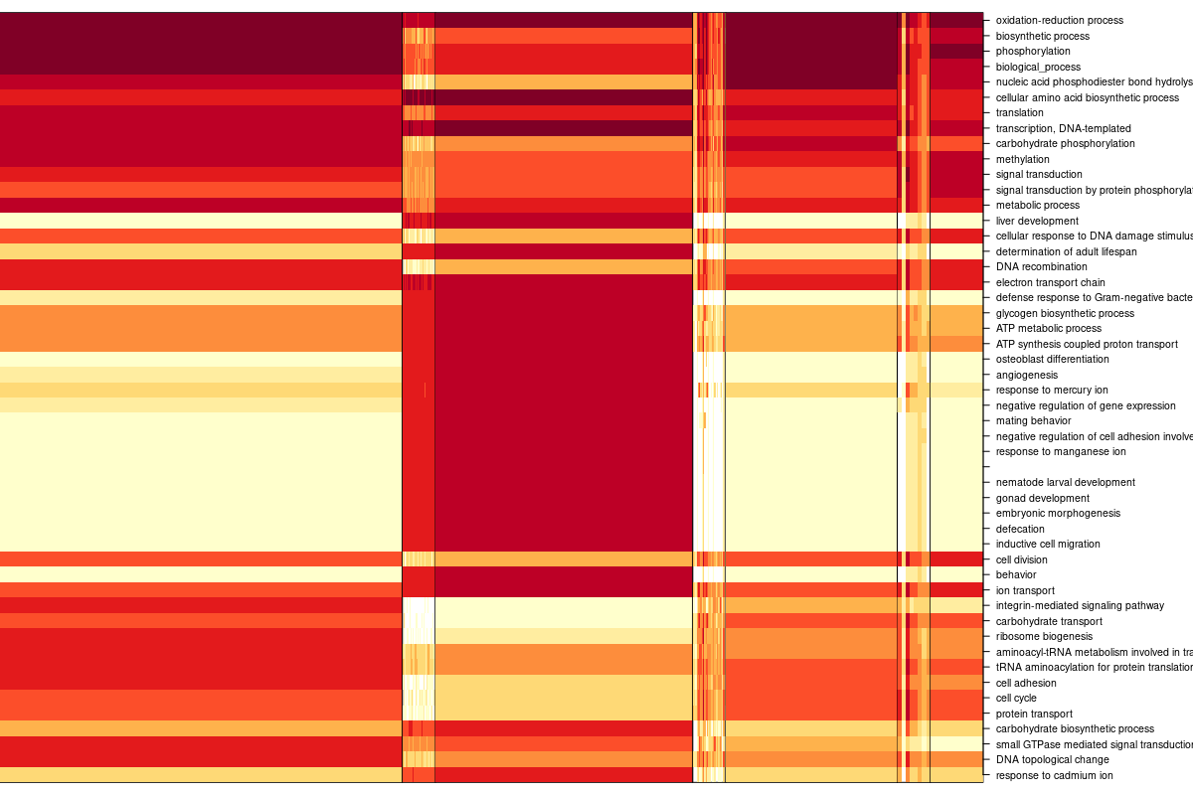
Log 10 Dirichlet Multinomial Mixtures Community typing (k=4)

Slide 7
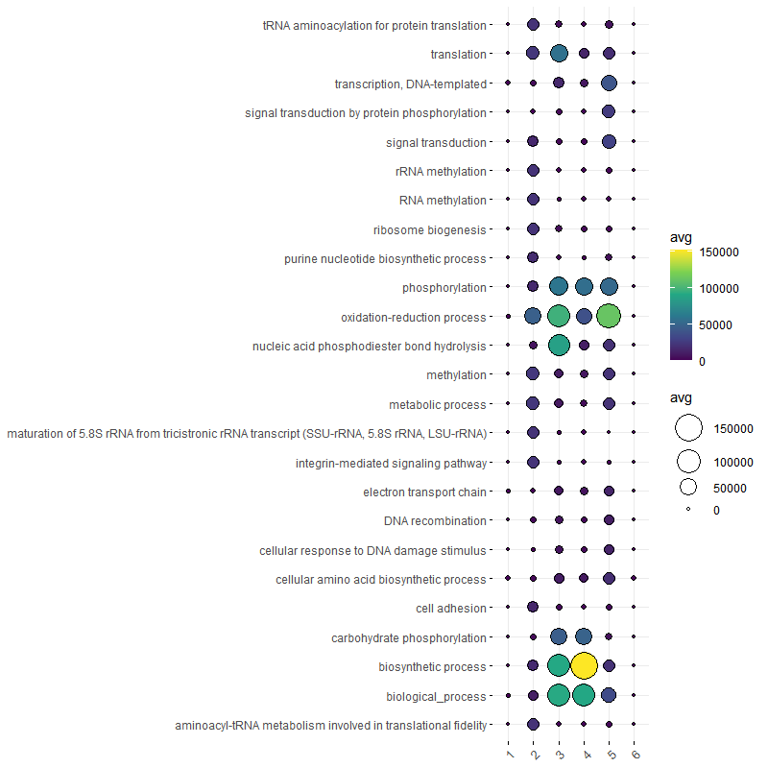
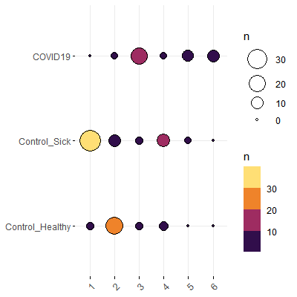
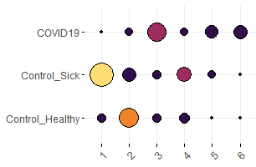
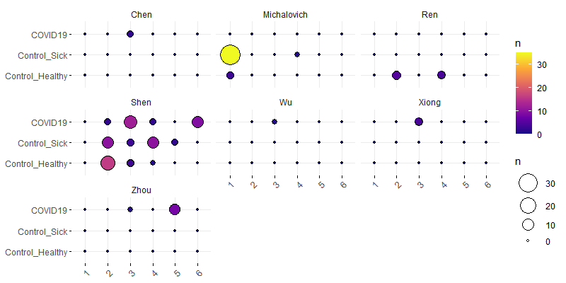
Bacteria derived biological process GO term Dirichlet Multinomial Mixtures Community typing (k=6)
DMM group (x) by case (y), colored by count
DMM group (x) by case (y) faceted by publication, colored by count

Slide 8
OLD STUFF Go term visualisations
Jochum, Michael D.
27 Oct 2020

Slide 9
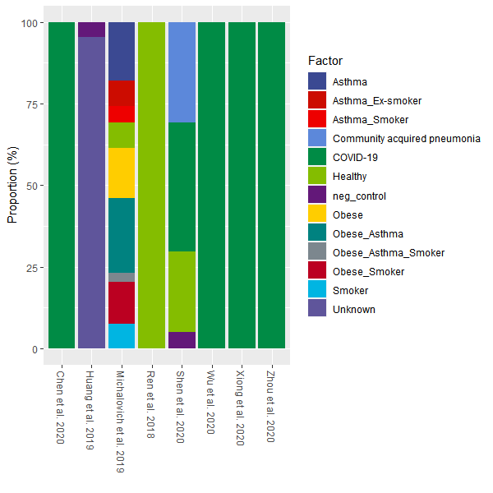
Proportion of samples types by publication

Slide 10
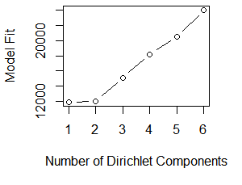
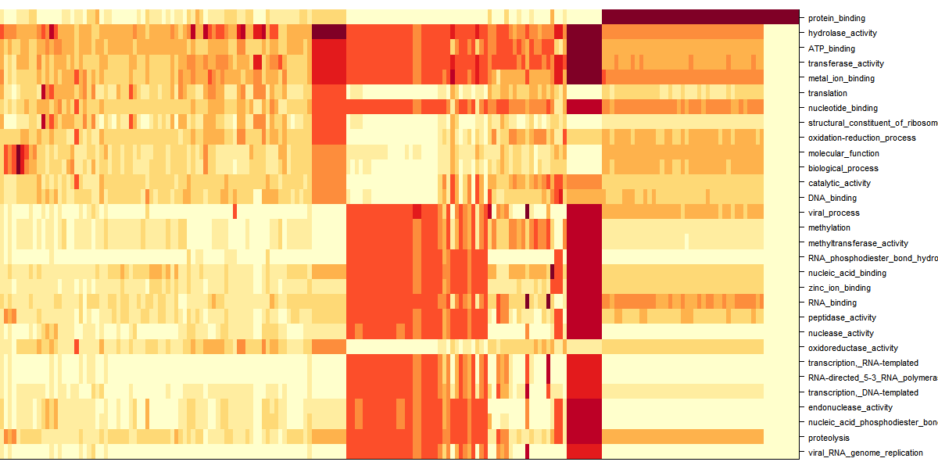
Dirichlet Multinomial Mixtures Community typing

Slide 11
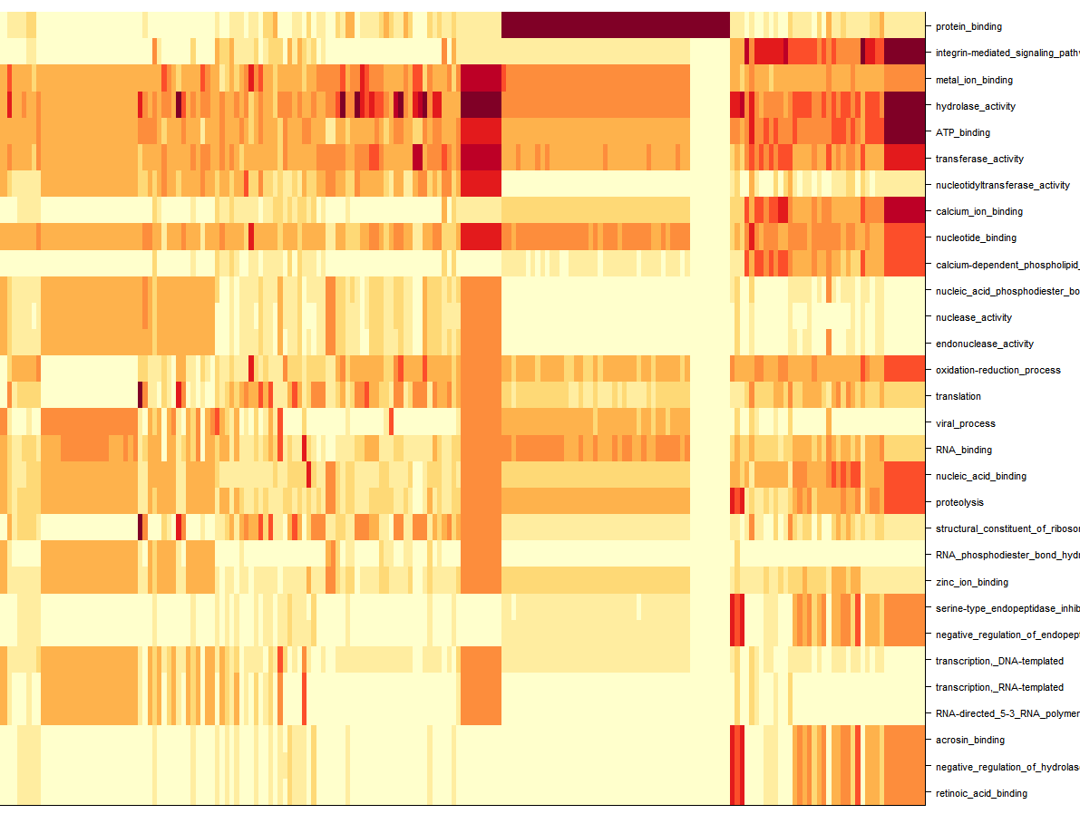
Dirichlet Multinomial Mixtures Community typing

Slide 12
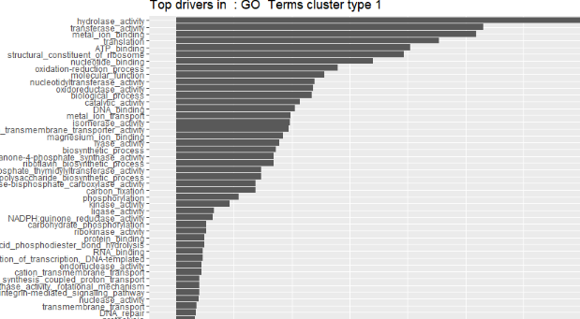
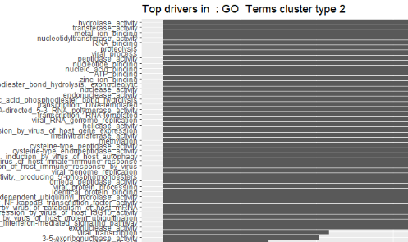
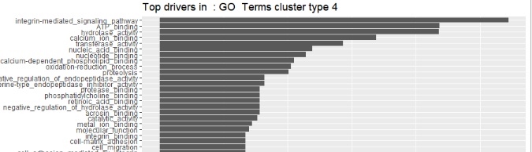
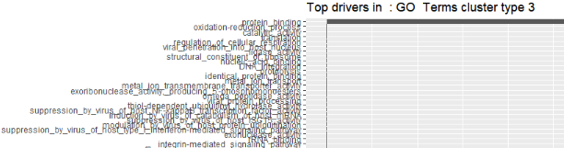
Dirichlet Multinomial Mixtures Community typing

Slide 13
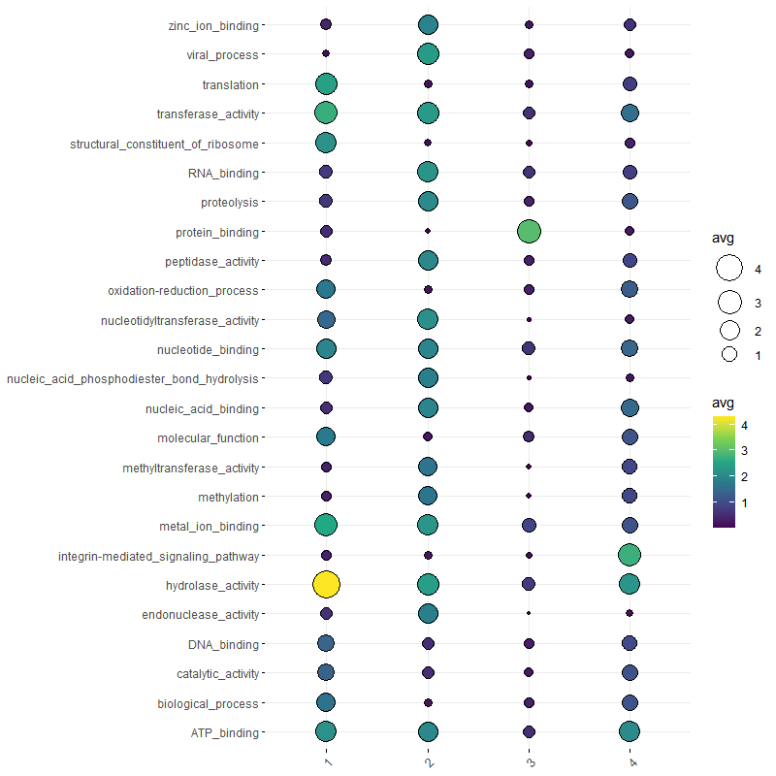
Dirichlet Multinomial Mixtures Community typing

Slide 14
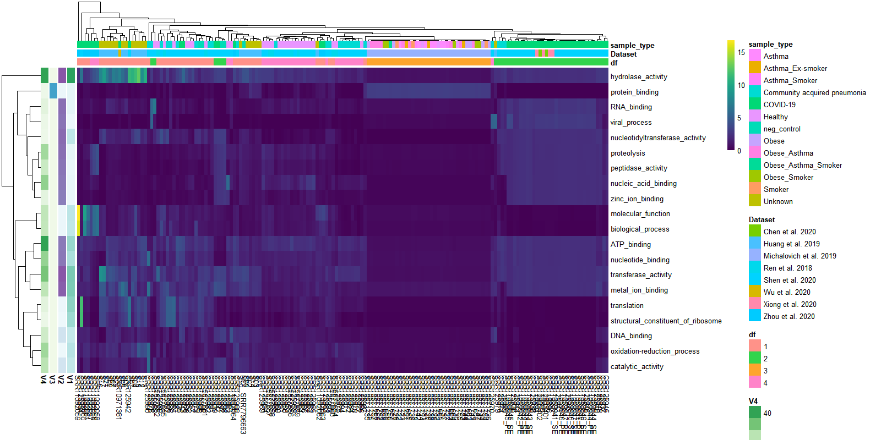
Dirichlet Multinomial Mixtures Community typing

